Slide 1
Infinity Model
Introduction to HTML

Slide 2
HTML
HTML (HyperText Markup Language) is the standard markup language used to create web pages. It is the backbone of every website, providing the fundamental structure and content.
.

Slide 3
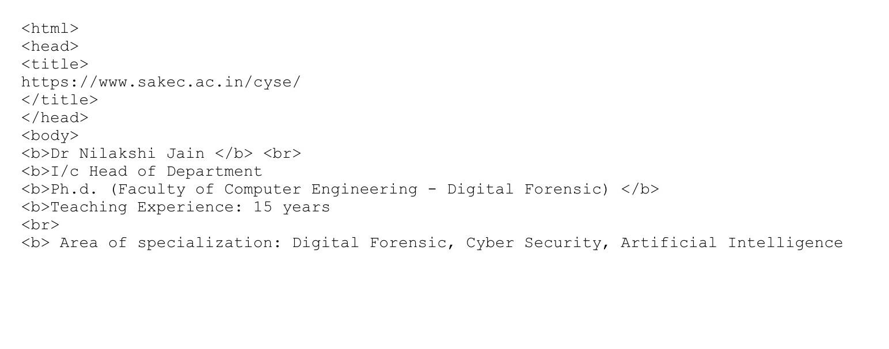
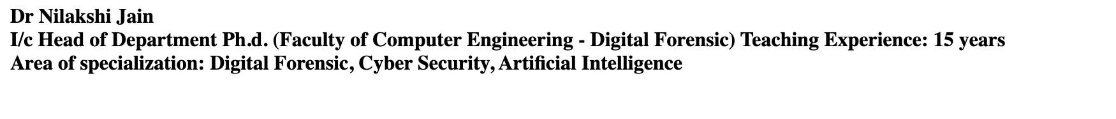
Experiment 1
In this code, we used bold letters and line breaks and even gave a title.

Slide 4
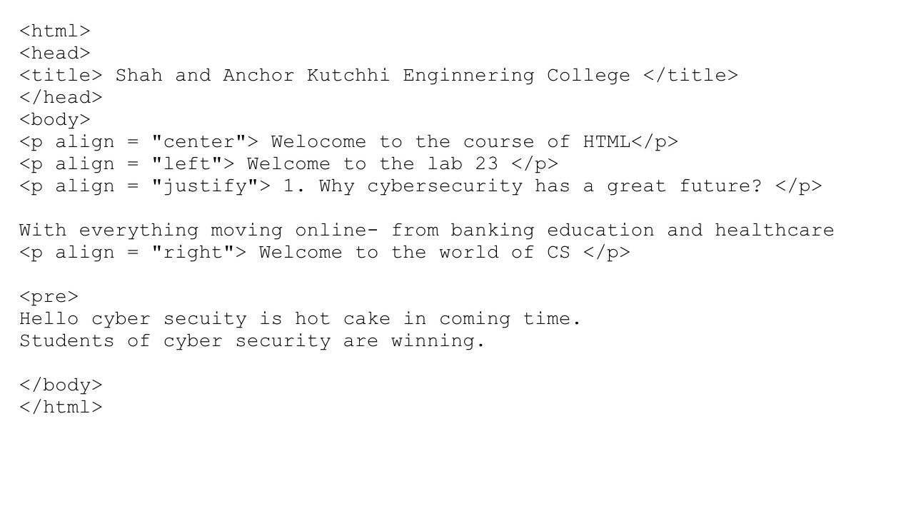
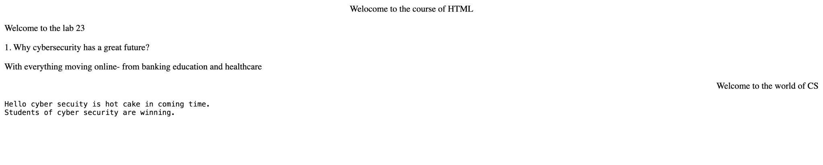
Experiment 2
In this code, we used different alignments and paragraph tag.

Slide 5
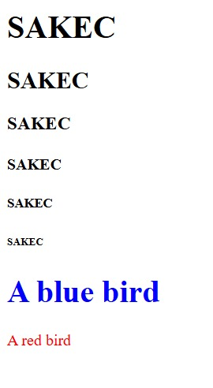
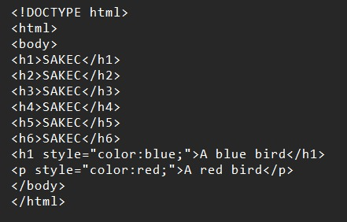
Experiment 3
In this code, we used different heading tags and also colors.

Slide 6
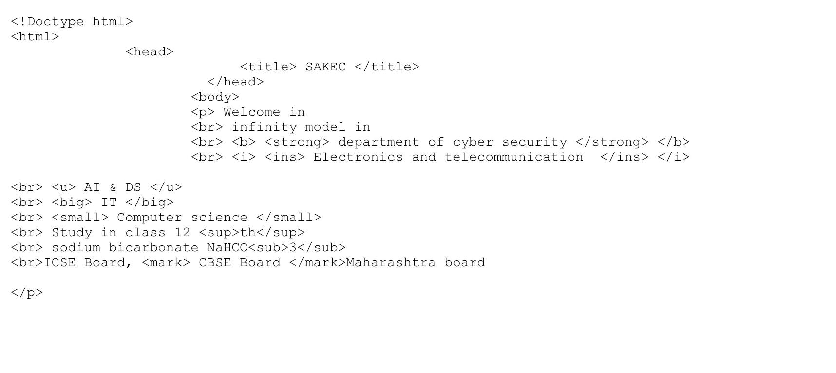
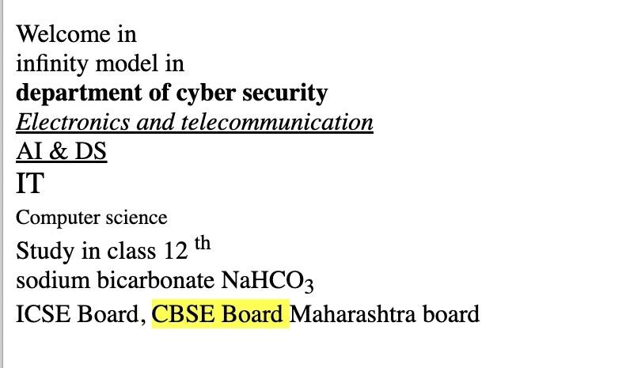
Experiment 4
In this code, we used different types of attributes like underline, italics, bold, etc.

Slide 7
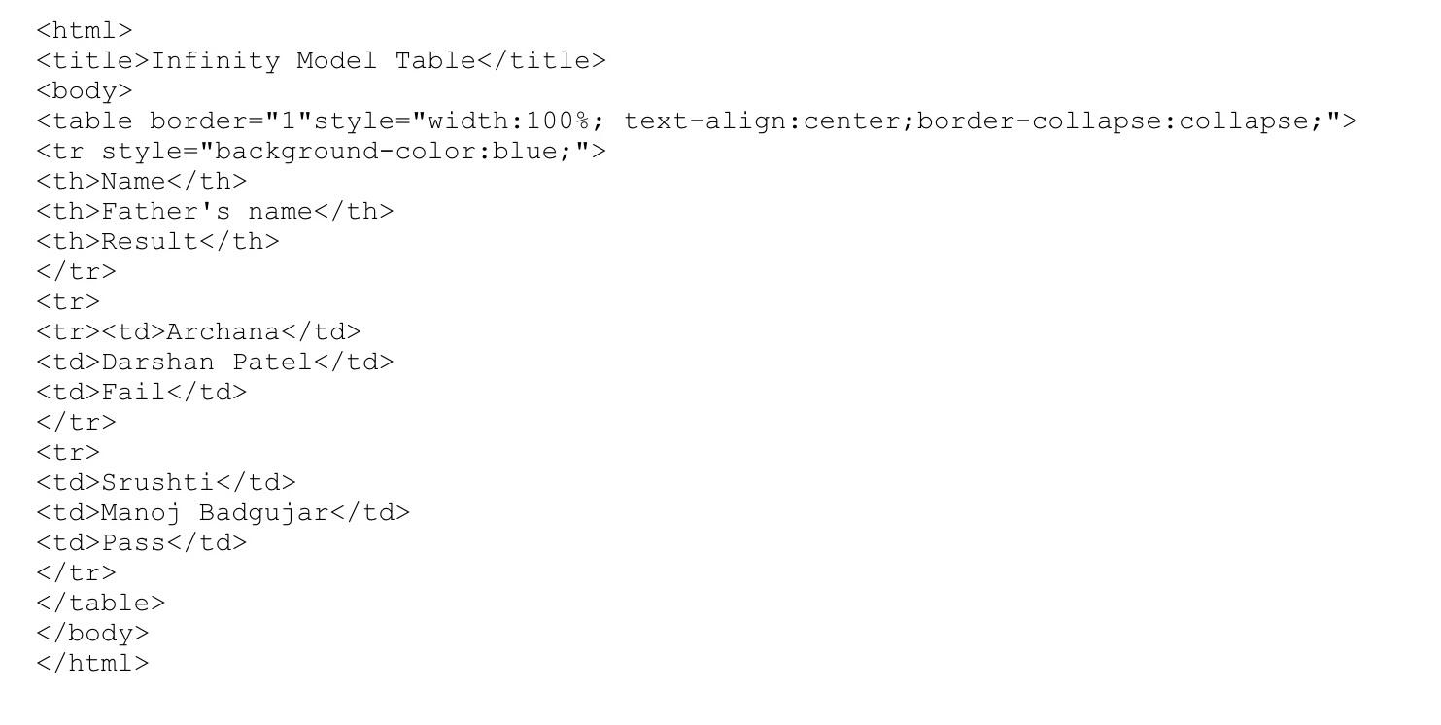
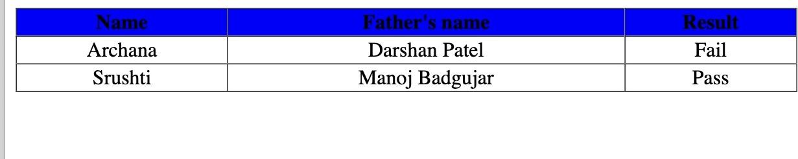
Experiment 5
In this code, we learned how to use tables.

Slide 8
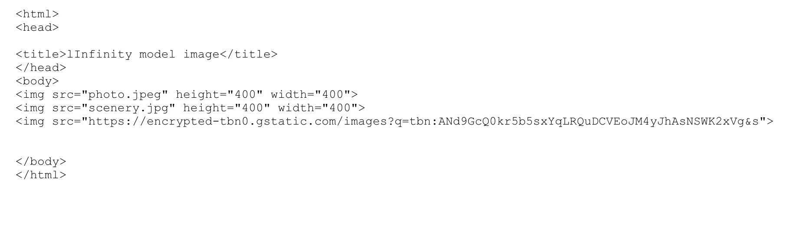

Experiment 6
In this code, we learned how to use photos and link them in different ways.

Slide 9
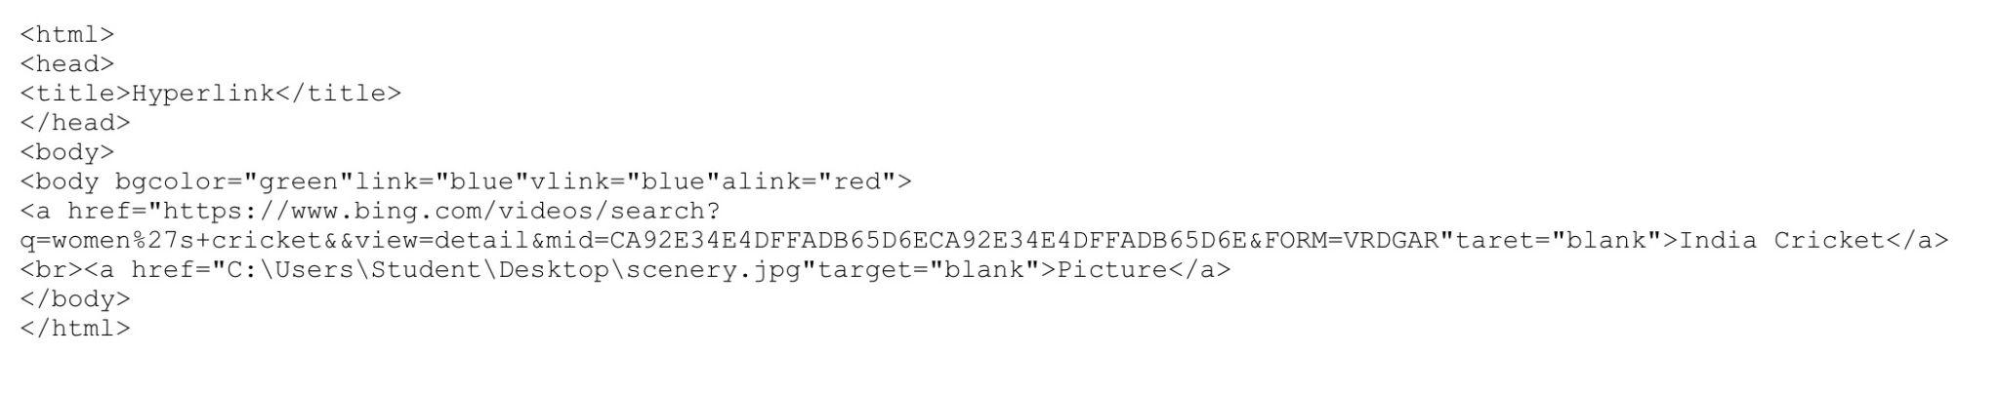
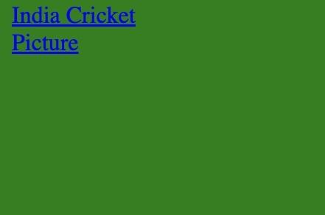
Experiment 7
In this code, we learned how to use links in different ways.

Slide 10
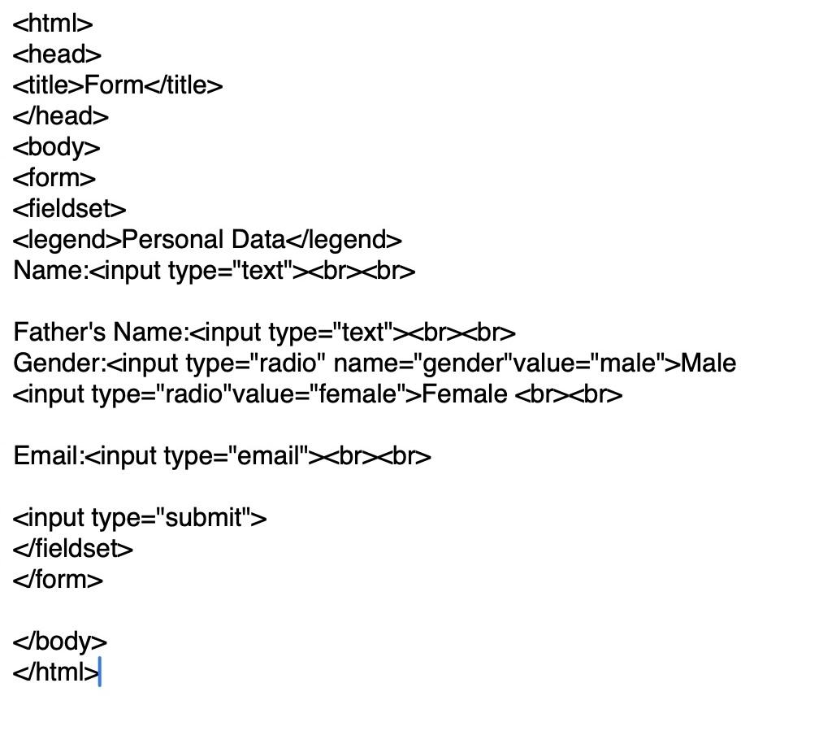
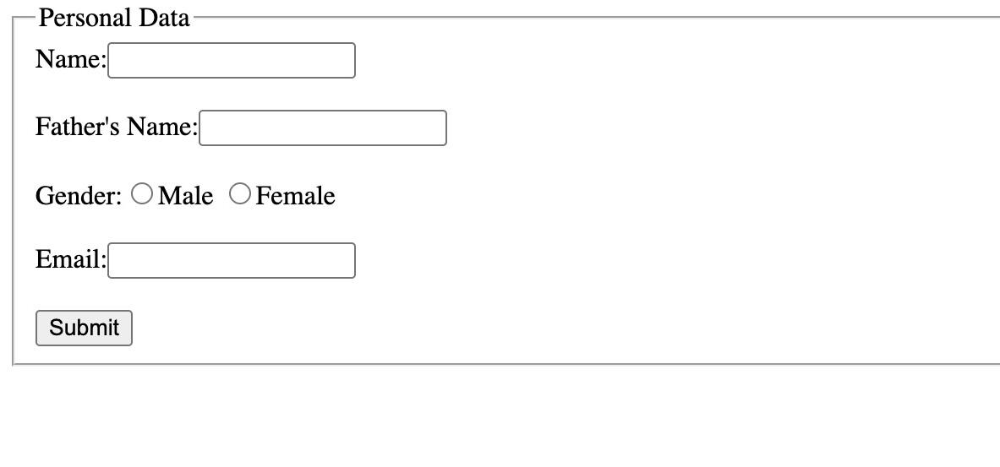
Experiment 8
In this code, we learned how to make form.

Slide 11
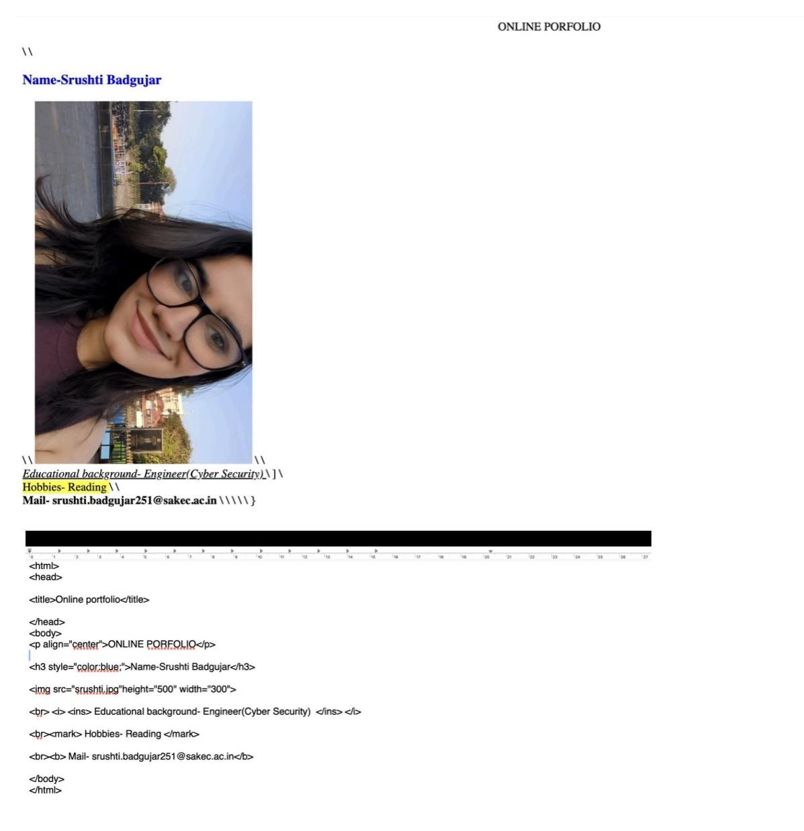
Experiment 1

Slide 12
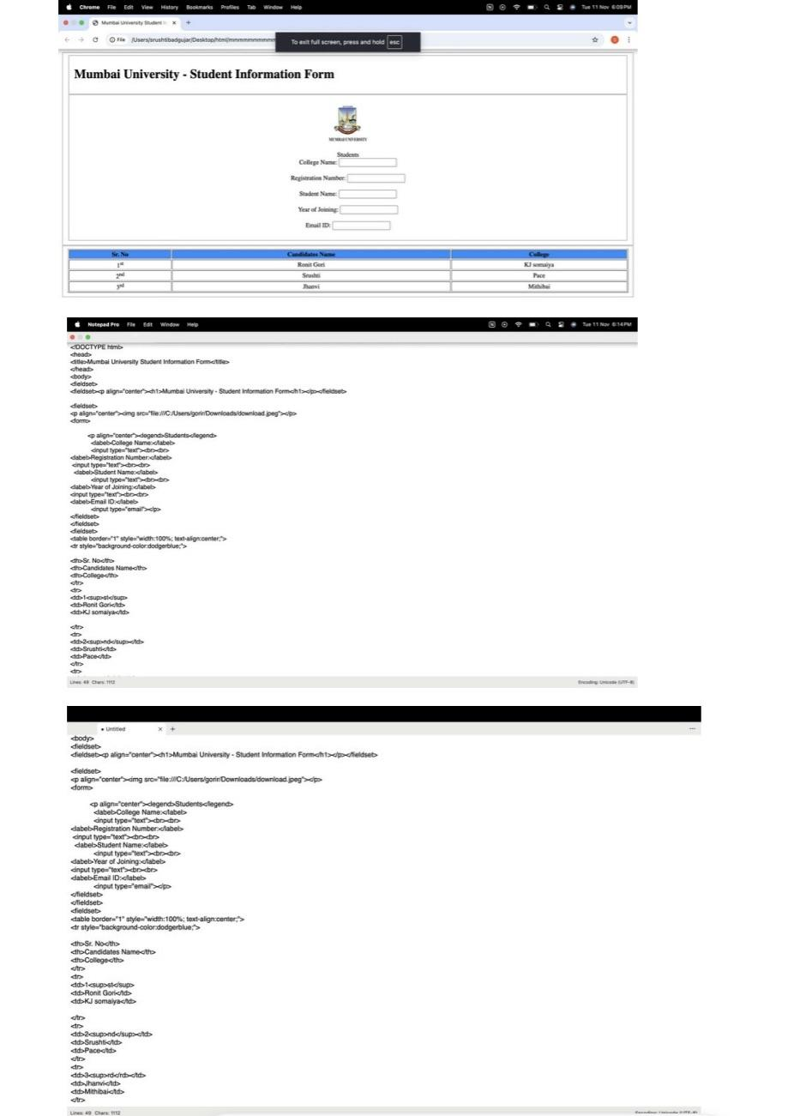
Experiment 2

Slide 13
Experiment 3

Slide 14
Thank you

